Slide 1
Association of Simple Machines Campus Candidate Tracker
Anubhaw Arya, Matthew Gotteiner, Scott Little
Notes:
We are a company that believes in simple, yet powerful machines

Slide 2
Problem
Blackwood Consulting is growing and seeking more campus hires
Need to keep track of recruiting data to in order to make informed decisions about hiring
Notes:
Blackwood Consulting – mid size firm
Large amount of recent growth
Management wants top talent from schools
Pressure on recruiting team
Recruiting team needs to keep track of their interactions with potential candidates – be able to make informed decisions

Slide 3
Current Solution
Keep separate spreadsheets containing candidate information for each school
Name | GPA | Major | Offer Status
John | 3.7 | Computer Science | Accepted
Bob | 3.3 | Business | Rejected
Alice | 3.5 | Computer Science | Pending
Notes:
One of the simplest possible solutions
Example of what one of the spreadsheets might look like
Numerous problems

Slide 4
Problems With Current Solution
Difficult to aggregate information
Hard to draw conclusions across schools
Cannot keep different team member’s information in sync
Name | GPA | Major | Offer Status
John | 3.7 | Computer Science | Accepted
Bob | 3.9 | Business | Rejected
Alice | 3.5 | Economics | Pending
Name | GPA | Major | Offer Status
John | 3.7 | Computer Science | Pending
Bob | 3.4 | Business | Rejected
Alice | 3.5 | Computer Science | Pending
Notes:
Separate spreadsheets for each school – blackwood cares about all candidates from all schools
Same type of data, different spreadsheets – cannot understand links between them
Want to know what major is the most hired? Gpa? Time consuming to go through all spreadsheets tallying
Use spreadsheet interface to enter candidate data
Separate spreadsheets means different team members have different copies
Merging issues – two different recruiters get two different candidates with same name? major?
Solution does not scale to large amount of hires
too much time wasted managing the process, not talking with candidates

Slide 5
Problems With Current Solution
Difficult to aggregate information
Hard to draw conclusions across schools
Cannot keep different team member’s information in sync
Name | GPA | Major | Offer Status
John | 3.7 | Computer Science | Pending
Bob | 3.4 | Business | Rejected
Alice | 3.5 | Computer Science | Pending
Notes:
Separate spreadsheets for each school – blackwood cares about all candidates from all schools
Same type of data, different spreadsheets – cannot understand links between them
Want to know what major is the most hired? Gpa? Time consuming to go through all spreadsheets tallying
Use spreadsheet interface to enter candidate data
Separate spreadsheets means different team members have different copies
Merging issues – two different recruiters get two different candidates with same name? major?
Solution does not scale to large amount of hires
too much time wasted managing the process, not talking with candidates

Slide 6
New Solution
Create a web-based recruiting information management system
All information in one place
Easier to understand the big picture
All team members see the same data
Notes:
Web-based system solves many problems
Data in 1 place
In database, not spreadsheet – designed to be querying in interesting ways we care about
All together – not fragmented
No merging needed
Everyone is on the same page

Slide 7
Required Features
Candidate Profiles
Capture resume information
Recruiting process state
Interview notes
Recruiting Events
Link candidates to events
Notes:
Capture standard resume information – gpa, major, name, etc
Recruiting process state – are we interviewing? Rejected, accepted, pending, etc
Keep track of interview notes, things to know about candidates
End goal: System to keep track of candidates through the entire recruiting process
Ideal is every interaction we have is stored here from meeting till hiring
Recruiting events – know who was coming to them
Allow us to understand what events have the most impact
Which events were most popular with people we hired? Had the least attendance? Etc…
System will help improve overall recruiting process

Slide 8
Solution Characteristics
Simple design
Controls in one place
Ease of use
Low learning curve
Minimal data entry
Mobile
Notes:
Consultants are very busy people – app should work with them, not against them
Simple design
Cornerstone of our approach
Ease of use
Pick up the app in minutes
Don’t have to enter long pieces of data every time
Easy to find information you want
Easy to change things

Slide 9
Demo

Slide 10
Technical Stack
Linux, Apache, MySQL, and PHP (LAMP)
Easy to implement
Easy to extend
Lots of support!

Slide 11
Further Development
Simple to extend
API
JSON
Intuitive relational database setup

Slide 12
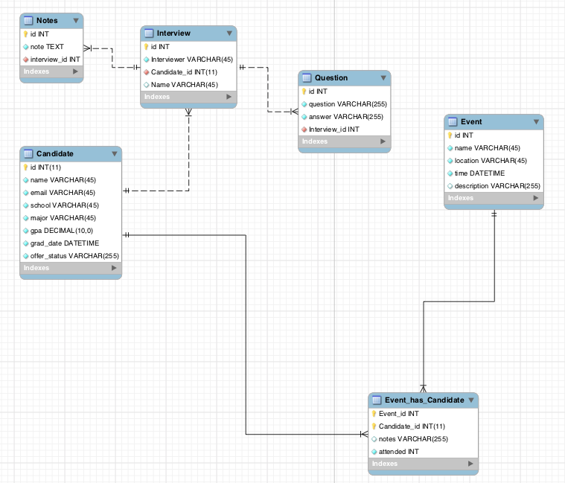

Slide 13
Support
Extended Support
Request features
Planned features
Resume parsing
One-Time Purchase
Develop your own plugins and features

Slide 14
Questions?

